Slide 1
Chapter 7

Slide 2
Objectives

Slide 3
Objectives (continued)

Slide 4
Properties of the Number object

Slide 5
Examples of properties of the Number object

Slide 6
Methods of the Number object

Slide 7
Examples of methods of the Number object

Slide 8
Common methods of the Math object

Slide 9
Examples of common methods of the Math object

Slide 10
Examples of common methods of the Math object (continued)

Slide 11
The random method of the Math object

Slide 12
Examples of the Math.random method

Slide 13
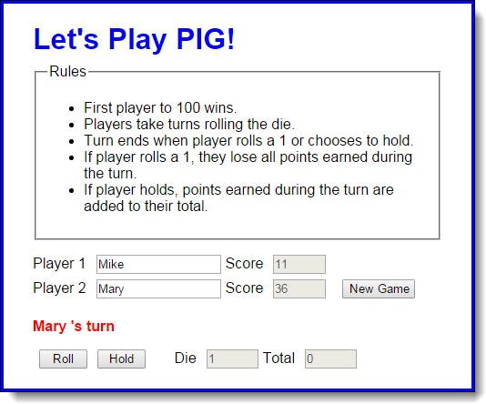
The user interface for the PIG application

Slide 14
The HTML for the PIG application

Slide 15
The HTML for the PIG application (continued)

Slide 16
The JavaScript for the PIG application

Slide 17
The JavaScript (continued)

Slide 18
The JavaScript (continued)

Slide 19
The JavaScript (continued)

Slide 20
Basic escape sequences

Slide 21
Examples of strings using the basic escape sequences

Slide 22
Escape sequences for some of the Unicode characters

Slide 23
Two ways to code Unicode escape sequences

Slide 24
One property of String objects

Slide 25
Methods of String objects

Slide 26
Examples of methods of String objects

Slide 27
Examples of methods of String objects (continued)

Slide 28
Example 1: How to trim spaces off the beginning of a string

Slide 29
Example 2: How to trim spaces off the end of a string

Slide 30
Example 3: How to combine ltrim and rtrim to trim all spaces

Slide 31
Example 4: How to compare two strings ignoring case

Slide 32
Example 5: A function for comparing two strings while ignoring case

Slide 33
How to create a Date object that represents the current date and time

Slide 34
How to create a Date object by specifying date parts

Slide 35
How to create a Date object by copying another date object

Slide 36
Some unexpected results when specifying a date string

Slide 37
How the constructor for the Date object works

Slide 38
The formatting methods of a Date object

Slide 39
The get methods of a Date object

Slide 40
The set methods of a Date object

Slide 41
Example 1: How to display the date in your own format

Slide 42
Example 2: How to calculate the days until the New Year

Slide 43
Example 3: How to calculate a due date

Slide 44
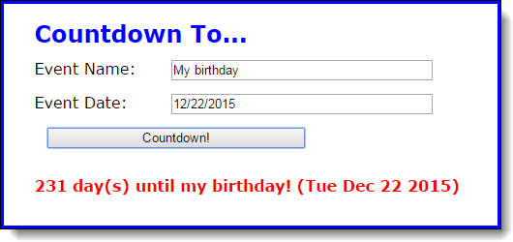
The user interface of the Count Down application

Slide 45
The HTML for the application

Slide 46
The CSS rule set for the <p> element

Slide 47
The JavaScript for the Countdown application

Slide 48
The JavaScript (continued)

Slide 49
The JavaScript (continued)

Slide 50
The JavaScript (continued)

Slide 51
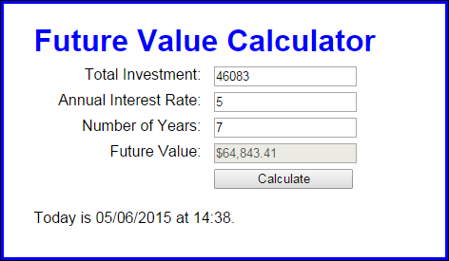
Exercise 7-1 Enhance the Future Value app

Slide 52
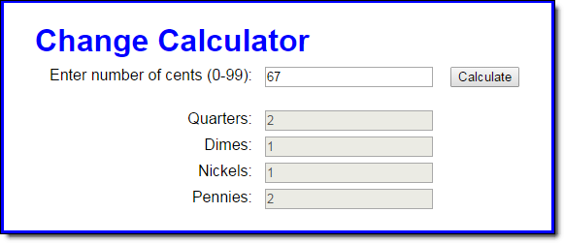
Extra 7-1 Develop the Change Calculator

Slide 53
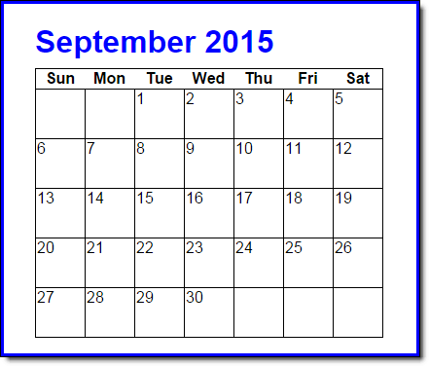
Extra 7-2 Develop the Calendar application

Slide 54
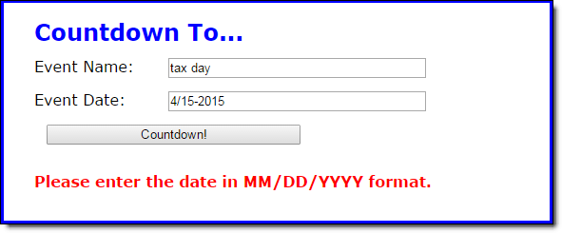
Short 7-1 Improve the Countdown validation

